Slide 1
Module 13

Slide 2

SURFACE AREAS
AND VOLUMES
HEMISPHERE- Introduction
Notes:
School
2

Slide 3
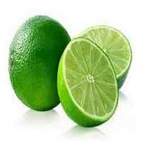
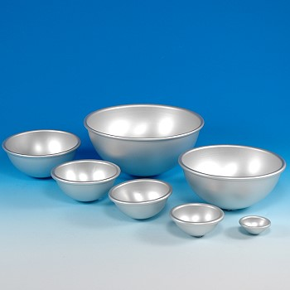
Half
Hemisphere
Hemisphere is half of a sphere
Let us consider examples of hemisphere
Examples :
Half-cut sweet lime
Hemispherical bowls

Slide 4
Hemisphere
A Hemisphere has two faces.
One circular face
r
One curved face
Let us see geometrical
figure of a hemisphere
Let the radius be r

Slide 5
CURVED SURFACE AREA OF HEMISPHERE
CSA = 2πr²
r
We know that,
Hemisphere is half of sphere
Curved surface area of sphere
CSA =
2
2
4πr²
=
2

Slide 6
TOTAL SURFACE AREA OF HEMISPHERE
TSA = 3πr²
Area of circular face = πr²
r
Curved surface area = 2πr²
TSA =
Curved surface area
+
Area of circular face
=
2πr²
+
πr²

Slide 7
VOLUME OF HEMISPHERE
2
Volume = πr³
3
r
We know that,
Volume is the capacity of the hemisphere
Hemisphere is half of sphere
1
Volume =
×
Volume of sphere
2
2
1
4
=
×
πr³
2
3

Slide 8
Module 14

Slide 9
SURFACE AREAS
AND VOLUMES
Sum based on Hemisphere
Notes:
School
9

Slide 10

1
Q. The curved surface area of a hemisphere is 905 cm²,
7
What is its volume?
Sol.
Hint :To find: r
144
3168
CSA of hemisphere
1
6336
× 7
= r²
= 905
cm²
∴
7
7 ×
2 × 22
=
(905 × 7)
+ 1
∴
r² = 144
7
6335
+ 1
∴
r = 12 cm
=
[Taking square roots]
7
CSA of hemisphere
=
6336
cm²
7
CSA of hemisphere
= 2r²
?
6336
∴
= 2r²
What is formula for finding volume of Hemisphere ?
What is formula for finding surface area of Hemisphere ?
$\frac{\text{2}}{\text{3}}$ πr³
7
2πr²
6336
22
∴
= 2
×
× r²
7
7

Slide 11
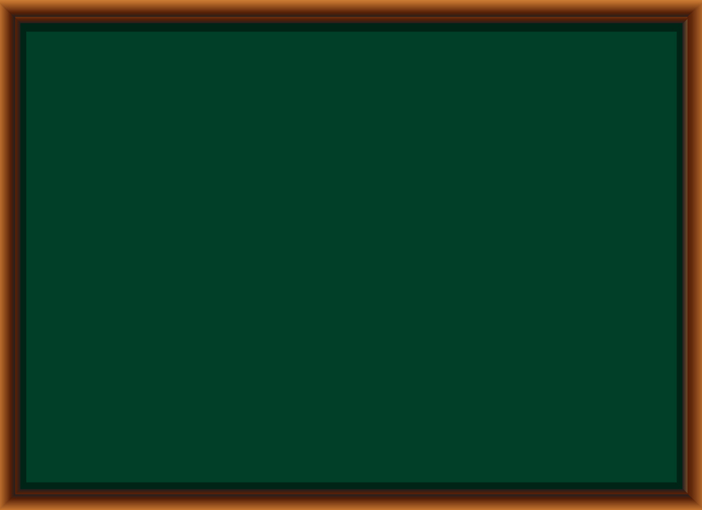
1
Q. The curved surface area of a hemisphere is 905 cm²,
7
What is its volume?
Sol.
r = 12 cm
2
Volume of hemisphere
=
r³
3
3
6
2
0
.
5
7
2
22
4
=
×
× 12
× 12
× 12
7
25344
3
7
–
21
2 × 22 × 4 × 12 × 12
4
=
3
7
–
42
4
25344
1
=
–
14
7
0
4
0
= 3620.57 cm³
–
35
0
5
–
49
∴ Volume of the hemisphere is 3620.57 cm³
1

Slide 12
Module 15

Slide 13
SURFACE AREAS
AND VOLUMES
Sum based on Cylinder
and Hemisphere
Notes:
School
13

Slide 14
Q.
A vessel is in the form of a hollow hemisphere mounted by a
hollow cylinder. The diameter of the hemisphere is 14 cm and the total
height of the vessel is 13cm. Find the inner surface area of the vessel.
✓
✓
✓
?
?
?
2 π r h
2 π r²
Inner surface area of vessel =
CSA of cylinder (S₁) +
CSA of hemisphere (S₂)
Sol.
Diameter =
14 cm
7cm
The vessel is made up
of cylinder and a
hemisphere
We know that,
7
d
14
∴
Radius =
=
= 7 cm
In Hemisphere,
2
2
What is the formula to find curved surface area of cylinder?
What is the formula to find curved surface area of hemisphere?
Radius =
Height
Height of cylinder
Let us find the height of the cylinder
?
6cm
= Height of vessel
– Height of Hemisphere
13cm
14cm
=
13 –
7
7cm
=
6 cm
7cm

Slide 15
Q.
A vessel is in the form of a hollow hemisphere mounted by a
hollow cylinder. The diameter of the hemisphere is 14 cm and the total
height of the vessel is 13cm. Find the inner surface area of the vessel.
2 π r h
2 π r²
Inner surface area of vessel =
CSA of cylinder (S₁) +
CSA of hemisphere (S₂)
Sol.
7cm
CSA of Cylinder (S₁)
=
2 π r h
=
2 × π
× 7
× 6
6cm
∴
CSA of Cylinder (S₁)
=
84π cm²
13cm
7cm
CSA of Hemisphere (S₂)
=
2 π r²
=
2 × π
× 7
× 7
7cm
∴
CSA of Hemisphere (S₂)
=
98π cm²

Slide 16
Q.
A vessel is in the form of a hollow hemisphere mounted by a
hollow cylinder. The diameter of the hemisphere is 14 cm and the total
height of the vessel is 13cm. Find the inner surface area of the vessel.
2 π r h
2 π r²
Inner surface area of vessel =
CSA of cylinder (S₁) +
CSA of hemisphere (S₂)
Sol.
S₁ = 84π
Inner surface area
of the vessel
7cm
=
S₁ + S₂
S₂ = 98π
=
84π
+ 98π
6cm
=
182
× π
13cm
26
22
7cm
=
182
×
7
7cm
=
26
× 22
=
572 cm²
∴
Inner surface area of the vessel is 572 cm²

Slide 17
Module 16

Slide 18
SURFACE AREAS
AND VOLUMES
Sum based on Cone and Hemisphere
Notes:
School
18

Slide 19

Q. A toy is in the form of a cone of radius 3.5 cm mounted on a
hemisphere of same radius. The total height of the toy is 15.5 cm.
Find the total surface area of the toy.
✓
✓
?
π r l
2 π r²
Total surface area of toy =
CSA of cone (S₁) +
CSA of hemisphere (S₂)
Sol.
The entire toy is made up of a cone and a hemisphere
We know that,
Height of cone
In Hemisphere,
= Height of vessel
l
What is the formula to find curved surface area of the hemisphere?
Let us find the slant height (l )
Radius =
Height
What is the formula to find curved surface area of cone ?
What is the formula to find slant height (l )?
– Height of Hemisphere
?
l = $\sqrt{r^{2}+ h^{2}}$
12 cm
=
15.5 –
3.5
=
15.5cm
12 cm
For getting the slant height (l ),
3.5 cm
Let us first find height (h)
3.5 cm

Slide 20




Q. A toy is in the form of a cone of radius 3.5 cm mounted on a
hemisphere of same radius. The total height of the toy is 15.5 cm.
Find the total surface area of the toy.
✓
✓
✓
?
π r l
2 π r²
Total surface area of toy =
CSA of cone (S₁) +
CSA of hemisphere (S₂)
Sol.
Slant height (l )
=
r²
+
h²
12.5 cm
=
(3.5)²
l
+
12²
12cm
=
+
12.25
144
15.5cm
=
3.5cm
156.25
∴
l
=
12.5 cm
3.5cm
Surface area of cone (S₁)
π r l
=
=
π
× 3.5
× 12.5
∴
Surface area of cone (S₁)
=
43.75πcm²

Slide 21
Q. A toy is in the form of a cone of radius 3.5 cm mounted on a
hemisphere of same radius. The total height of the toy is 15.5 cm.
Find the total surface area of the toy.
π r l
2 π r²
Total surface area of toy =
CSA of cone (S₁) +
CSA of hemisphere (S₂)
Sol.
Surface area of hemisphere(S₂)
2πr²
=
=
2π
× (3.5)²
=
2π
× 3.5
× 3.5
12cm
∴
Surface area of hemisphere(S₂)
=
24.5πcm²
3.5cm
15.5cm
=
S₁ + S₂
Total surface
area of the toy
=
43.75π
+
24.5π
3.5cm
=
68.25π
9.75
22
×
=
68.25
7
S₁ = 43.75π
=
214.25 cm²
∴
Total surface area of the toy is 214.25 cm².

Slide 22
Module 17

Slide 23
SURFACE AREAS
AND VOLUMES
Sum based on Cube and Hemisphere
Notes:
School
23

Slide 24
Q. A cubical block of side 7 cm is surmounted by a hemisphere.
What is the greatest diameter the hemisphere can have ?
Find the surface area of the solid.
✓
✓
✓
?
?
6l²
π r²
2 π r²
=
–
Surface area of the solid
TSA (cube)
Base Area (hemisphere)
+
CSA (hemisphere)
Sol.
Greatest diameter
=
Side of a square
= 7 cm
Diameter =
7 cm
What is the formula to find curved surface area of hemisphere?
Greatest Diameter =
Side of Square =
What is the formula
to find TSA of cube?
7 cm
d
7
What is the formula to find area of a circle?
∴
r =
=
cm
2
2
7 cm
?
7 cm

Slide 25
Q. A cubical block of side 7 cm is surmounted by a hemisphere.
What is the greatest diameter the hemisphere can have ?
Find the surface area of the solid.
6l²
π r²
2 π r²
=
–
Surface area of the solid
TSA (cube)
Base Area (hemisphere)
+
CSA (hemisphere)
Sol.
TSA of cube =
6l²
=
6 ×
7²
=
6 × 49
7 cm
= 294 cm²
7 cm

Slide 26
Q. A cubical block of side 7 cm is surmounted by a hemisphere.
What is the greatest diameter the hemisphere can have ?
Find the surface area of the solid.
6l²
π r²
2 π r²
=
–
Surface area of the solid
TSA (cube)
Base Area (hemisphere)
+
CSA (hemisphere)
Sol.
294
TSA (cube)
=
Surface area of the solid
=
TSA (cube)
–
Base Area (hemisphere)
7
+
CSA (hemisphere)
Radius =
cm
= 294
– πr²
+ 2πr²
2
= 294 + πr²
7 cm
11
22
×
7
×
7
= 294 +
7 cm
7
2
2
77
= 294 +
2
= 294 + 38.5
= 332.5 cm²
∴
Surface area of the solid is 332.5 cm²

Slide 27
Module 18

Slide 28
SURFACE AREAS
AND VOLUMES
Sum based on Cube and Hemisphere
Notes:
School
28

Slide 29

Q. A hemispherical depression is cut out from one face of a cubical
wooden block such that the diameter ‘l ’ of the hemisphere is
equal to the edge of the cube. Determine the surface area of the
remaining solid.
l
Sol.
Edge of the cube =
Diameter of hemisphere
= l
l
Radius of hemisphere (r) =
l
2
Surface area of the remaining solid
=
–
SA (cube)
A (hemispherical top)
+
CSA (hemisphere)
πl²
=
6l²
– πr²
+ 2 π r²
= 6l² +
4
=
Radius (r) = $\frac{\text{Diameter}}{\text{2}}$
6l²
+ π r²
24l²
+
πl ²
=
4
l
What is the formula to find curved surface area of hemisphere?
= 6l² +
π
²
What is the formula to find
total surface area of cube?
2
1
2πr²
What is the formula to find area of a circle?
6l ²
=
l²
(24 + π)
sq.units
πr²
4
1
∴
Surface area of the remaining solid
=
l²
(24 + π)
sq.units
4

Slide 30
Module 19

Slide 31
SURFACE AREAS
AND VOLUMES
Sum based on Cylinder and Hemisphere
Notes:
School
31

Slide 32
Q. A medicine capsule is in the shape of a cylinder with two
hemispheres stuck to each of its ends. The length of the entire
capsule is 14mm and the diameter of the capsule is 5 mm.
Find its surface area.
✓
✓
✓
?
?
?
2 π r h
2 π r²
Total surface area of capsule =
CSA of cylinder (S₁) +
2 CSA of hemisphere(S₂)
Sol.
Diameter =
5 mm
∴
d
5
Radius (r) =
=
= 2.5 mm
2
2
5 mm
?
Length of the cylinder (h) =
14
– 2.5
– 2.5
2.5 mm
9 mm
2.5 mm
∴
h
= 9mm
CSA of the cylinder (S₁) =
2 π r h
14 mm
The entire capsule is made up of a cylinder and two hemispheres
=
2 × π
× 2.5
× 9
What is the formula to find curved surface area of hemisphere ?
We know that,
What is the formula to find curved surface area of cylinder ?
Let us find the height of the cylinder
∴
In Hemisphere,
CSA of the cylinder (S₁)
=
45π mm²
Radius =
Height
CSA of 2 hemispheres (S₂) =
2 × 2πr²
=
2 × 2 × π
× (2.5)²
∴
CSA of 2 hemispheres (S₂)
=
25π mm²

Slide 33
Q. A medicine capsule is in the shape of a cylinder with two
hemispheres stuck to each of its ends. The length of the entire
capsule is 14mm and the diameter of the capsule is 5 mm.
Find its surface area.
2 π r h
2 π r²
Total surface area of capsule =
CSA of cylinder (S₁) +
2 CSA of hemisphere(S₂)
Sol.
TSA of the capsule =
S₁ + S₂
5 mm
=
45π
+
25π
2.5 mm
2.5 mm
=
70π
14 mm
10
22
S₁ = 45π
=
70
×
7
=
220 mm²
S₂ = 25π
∴
Surface area of the capsule is 220 mm²

Slide 34
Module 20

Slide 35
SURFACE AREAS
AND VOLUMES
Sum based on Cylinder and Cone
Notes:
School
35

Slide 36


Q. A tent is in the shape of a cylinder surmounted by a conical top.
If the height and diameter of the cylindrical part are 2.1 m and
4 m respectively, and the slant height of the top is 2.8 m,
find the area of the canvas used for making the tent. Also, find the
cost of the canvas of the tent at the rate of Rs. 500 per m².
(Note that the base of the tent will not be covered with canvas.)
✓
✓
✓
?
✓
?
π r l
2 π r h
TSA of tent =
CSA of cone (S₁) +
CSA of cylinder (S₂)
Sol.
Diameter =
4 m
2
d
4
2.8m
∴
Radius =
=
= 2 m
2
2
What is the formula to find curved surface of cylinder?
The tent is made up of a cone and a cylinder
What is the formula to find curved surface of cone?
i.e. we need to total
surface area of the tent
2 m
4m
2.1m

Slide 37
Q. A tent is in the shape of a cylinder surmounted by a conical top.
If the height and diameter of the cylindrical part are 2.1 m and
4 m respectively, and the slant height of the top is 2.8 m,
find the area of the canvas used for making the tent. Also, find the
cost of the canvas of the tent at the rate of Rs. 500 per m².
(Note that the base of the tent will not be covered with canvas.)
π r l
2 π r h
TSA of tent =
CSA of cone (S₁) +
CSA of cylinder (S₂)
Sol.
CSA of cone (S₁)
=
π r l
2.8m
=
π
×
2
×
2.8
∴
CSA of cone (S₁)
=
5.6π m²
2 m
CSA of cylinder (S₂)
=
2 π r h
2.1m
=
2
×
π
×
2
×
2.1
∴
CSA of cylinder (S₂)
=
8.4πm²

Slide 38
Q. A tent is in the shape of a cylinder surmounted by a conical top.
If the height and diameter of the cylindrical part are 2.1 m and
4 m respectively, and the slant height of the top is 2.8 m,
find the area of the canvas used for making the tent. Also, find the
cost of the canvas of the tent at the rate of Rs. 500 per m².
(Note that the base of the tent will not be covered with canvas.)
TSA of tent =
CSA of cone (S₁) +
CSA of cylinder (S₂)
Sol.
TSA of tent
=
S₁
+
S₂
=
5.6 π
+
8.4 π
2.8m
=
14
×
π
2
S₁ = 5.6π
Total cost of the canvas of the tent =
22
=
14
×
×
2 m
TSA of tent
S₂ = 8.4π
7
Rate
∴
TSA of tent
=
44m²
2.1m
Total cost of the canvas
=
TSA of tent
×
rate
=
44
×
500
∴
Total cost of the canvas
=
Rs. 22000

Slide 39
Thank You

